Slide 1
Wine Quality Analysis using Machine Learning Techniques Alicja Czajkowska magda leszczynska Paulina Luty Anna Skowron

Slide 2
Problem statement
Preservatives in wines - necessary ingredient but how much is too much?
Does it influence other attributes of wine?
Alcohol content
Understand dependencies between different wine attributes
Can we answer these questions by using the data about already made wines?

Slide 3
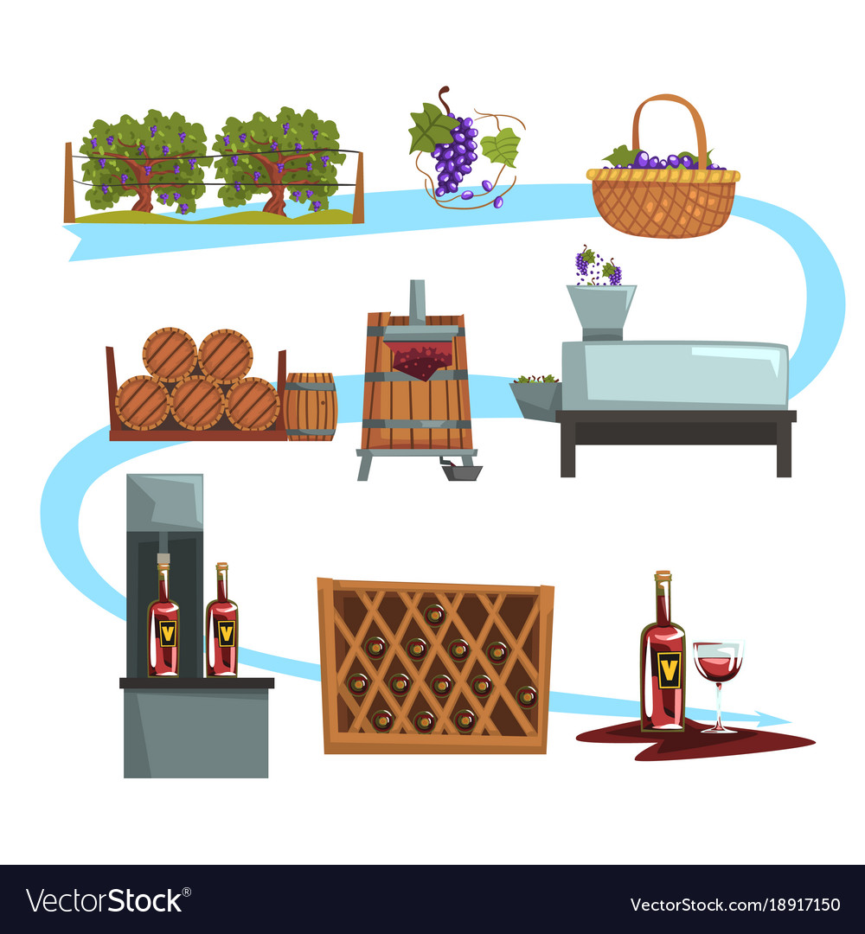
Production process impact the attributes of wines

Slide 4
Data
fixed acidity measure of tartaric acid [g/dm3]
volatile acidity amount of acetic acid [g/dm3]
citric acid - amount of citric acid [g/dm3]
residual sugar - amount of residual sugar [g/dm3]
Chlorides amount of sodium chloride [g/dm3]
free sulfur dioxide measure of sulfur dioxide [mg/dm3]
total sulfur dioxide measure of sulfur dioxide [mg/dm3]
Density amount of undissolved sugar [g/cm3]
pH potential of hydrogen of wine [mole]
sulphates amount of potassium sulphate [g/dm3]
Alcohol [vol.%]
Quality number from range 0 -10

Slide 5
Models
Classification techniques – clustering – unsupervised learning
Machine Learning technique:
Naïve Bayes
Decision Tree
Random Forest
Gradient Boosted Trees
Generalized Linear Model
Support Vector Machine

Slide 6
Conclusions
Gradient Boosted Technique – the highest accuracy to predict:
88% - level of alcohol without given alcohol content
77.5% - level of preservatives without given chlorides
88% - balanced wine without given preservatives - total sulfur dioxide
90% - Generalized Linear model – the highest accuracy to predict sugar/ph ratio, without Ph level
67% - Random Forest to predict quality rank

Slide 7
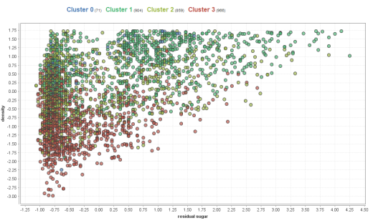
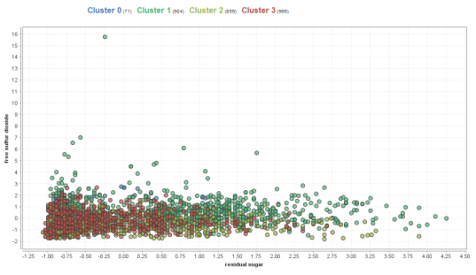
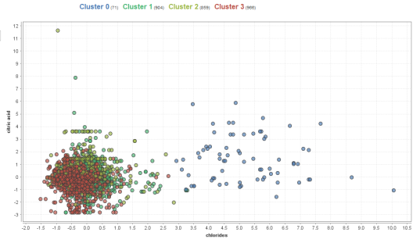
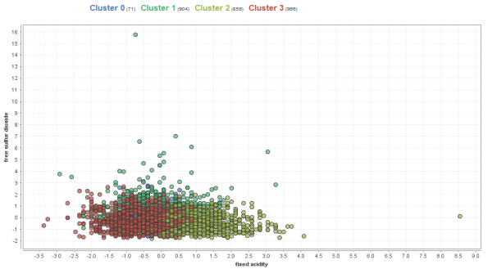
Conclusions - Patterns
4 clusters among more than 4,000 wines found
Dependencies
Ph/sugar ratio and chlorides
Ph/sugar ratio and Fixed acidity
Residual sugar and density
Difficult to predict Quality

